Slide 1

NAME : ARKAPRATIM GHOSH
ROLL No. : 13000121058
REG. No. : 211300100110045
TOPIC: Regula-Falsi Method
Paper Name: Numerical Methods
Paper Code: OEC-IT601A
CSE, 6th Sem (2021-2025), CA-1

Slide 2
CONTENT
Prerequisites
Main Algorithm
Computer Program and Example
Advantages
Limitations
Conclusion
Reference

Slide 3
PREREQUISITES
The Regula Falsi method, also known as the false position method, is a numerical method for finding the roots of a real-valued function. Before using this method, there are certain prerequisites and conditions that should be considered:
Continuous Function: The function f(x) must be continuous on the interval [a,b] where the root is expected.
Change of Sign: The method requires that the function f(x) has opposite signs at the endpoints of the interval [a,b]. In other words, f(a)⋅f(b)<0. This ensures that there is at least one root within the interval.
Differentiability: It's preferable that f(x) is differentiable on the interval, as the method involves finding the slope of the secant line to estimate the root.
Convergence Criteria: The method may not converge in some cases, especially if the function has flat regions or multiple roots. It's important to set a convergence criteria to stop the iterations when the solution is sufficiently accurate.
Monotonicity or Convexity: While not a strict requirement, the method may converge faster if the function is monotonic or convex on the interval. In cases where the function changes rapidly, convergence may be slower.

Slide 4
MAIN ALGORITHM
Given a continuous function f(x) on the interval [a,b] such that f(a)⋅f(b)<0, indicating a change of sign:
Initialization: Choose initial guesses x₀ and x₁ such that f(x₀)⋅f(x₁)<0. Set the iteration counter i=0.
Iteration: Calculate the next approximation x_{i}+1 using the formula: x_{i+1} = f(x)−f(x_{i+1})f(x)⋅a−f(x_{i+1})⋅b
Convergence Check: Check if ∣f(x_{i+1})∣ is less than a predefined tolerance or if the number of iterations has reached a specified limit. If the convergence criteria are met, the iteration is stopped, and x_{i+1} is considered the root.
Update Interval: Update the interval [a,b] based on the signs of f(x0) and f(xi+1): If f(x0)⋅f(xi+1)<0, set a=x and b=xi+1 If f(x)⋅f(xi+1)>0, set a=xi+1 and b=x1
Iteration Increment: Increment the iteration counter i=i+1.
Repeat: Go back to step 2 and repeat the process until the convergence criteria are met.

Slide 5
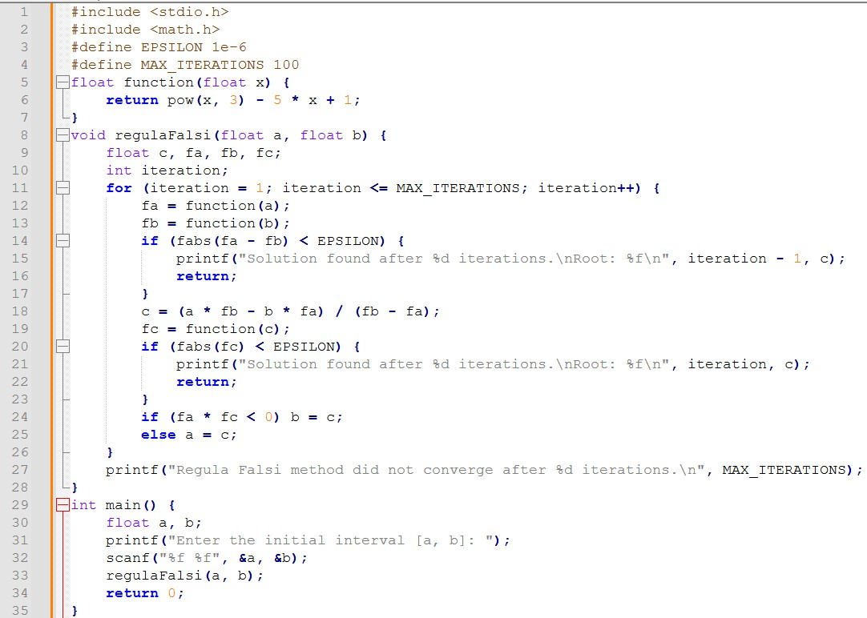
COMPUTER PROGRAM AND EXAMPLE

Slide 6
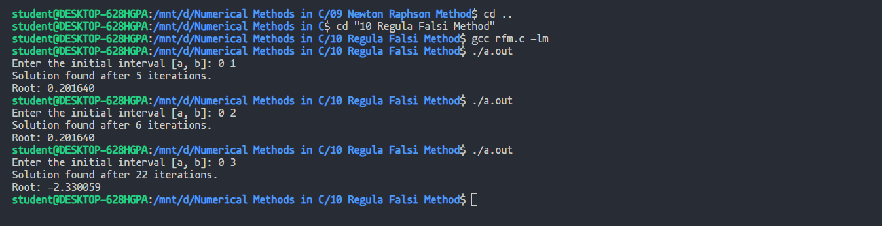
COMPUTER PROGRAM AND EXAMPLE
For function f(x)=x³−5x+1

Slide 7
ADVANTAGES
Faster Convergence: The Regula Falsi method often converges faster than the Bisection method due to its use of a linear approximation (secant line) to the function.
Open Method: It doesn't require the initial interval to bracket the root, making it applicable when an approximate location of the root is known.
Continuous Function: Works well for continuous functions, as it relies on linear interpolation between function values.
No Fixed Point Required: Unlike the Fixed-Point Iteration method, it doesn't require finding a fixed point, making it applicable to a broader range of functions.

Slide 8
LIMITATIONS
Slow Convergence in Flat Regions: The Regula Falsi method may converge slowly or even fail to converge in flat regions of the function where the slope approaches zero. It relies on linear interpolation, and if the function is nearly horizontal, progress can be sluggish.
Potential for Oscillation: Oscillation between two points may occur in certain situations, leading to slower convergence or failure to converge. This behavior can be problematic, especially when the method alternates between two points without getting closer to the root.
Sensitive to Initial Guesses: The method's performance can be sensitive to the choice of initial guesses. Poorly chosen initial points may lead to slow convergence or divergence.
Difficulty with Multiple Roots: Regula Falsi may encounter difficulties when dealing with functions having multiple roots within the same interval. It may converge to a different root or struggle to converge when there are multiple solutions.
Not Guaranteed Convergence: The method is not guaranteed to converge for all functions and initial intervals. Certain functions or poorly chosen intervals may cause the method to fail to find a root.
Convergence Criteria: Determining an appropriate convergence criterion is crucial. If not chosen carefully, it might lead to premature termination or unnecessary iterations, affecting the efficiency of the method.

Slide 9
CONCLUSION
In conclusion, the Regula Falsi method, or false position method, is a numerical technique for finding roots of a real-valued function. While it offers advantages such as faster convergence compared to the Bisection method and applicability as an open method, it comes with certain limitations.
The method may face challenges in flat regions of the function, exhibit sensitivity to initial guesses, and encounter difficulties with multiple roots. Oscillations between points and the absence of guaranteed convergence for all functions and intervals are important considerations. Additionally, the Regula Falsi method assumes the continuity of the function within the chosen interval, limiting its applicability to functions with discontinuities.
Users should carefully choose initial guesses, set appropriate convergence criteria, and consider alternative methods based on the characteristics of the problem. Despite its limitations, the Regula Falsi method remains a valuable tool for root-finding in situations where its strengths align with the nature of the function and the problem at hand.

Slide 10
REFERENCE
NUMERICAL METHODS Theoretical and Practical by K.Das
THANK YOU

